Slide 1



Causes of mortality, diseases and potential threats of ospreys
Oliver Krone
Leibniz Institute for Zoo and Wildlife Research

Slide 2
Osprey
Pandion haliaetus
morph: white underparts, brownish-black back, dark eye stripe, barred tail(♂ dark spotted breast)
iris: yellow (in young birds brown); weight: ♀ 1120-1740g wings.150-170cm
  ♂ 1208-2050g
habitat: water (seashore, lakes, rivers), breeds on large trees and pylons, ground breeder
breeding density: Brandenburg 0,4 BP/100km²
population: ~400-500 BP/BRD
range: world wide (4ss)

Slide 3
Post mortem examination

Slide 4
anual cycle
migrating, wintering
D
J
N
F
O
M
S
A
breeding
A
M
J
J
fledging
begging flight period

Slide 5
analysed sample

Slide 6
electrocution
entangeled
brocken legs

Slide 7
malformation

Slide 8
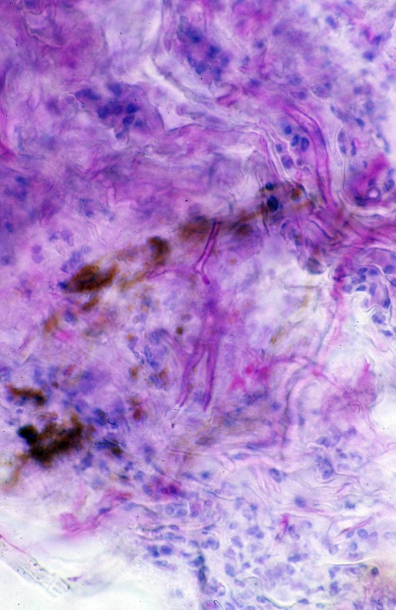
Candidiasis
C. albicans

Slide 9
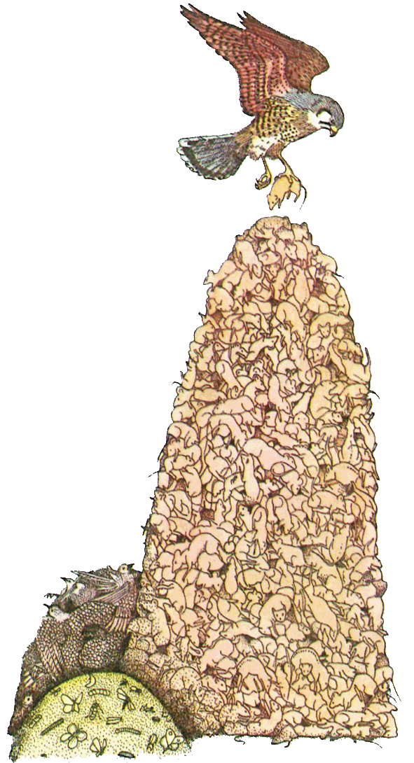
Background
Monitoring pollutants
Bioindicators
Raptors
- well known, emblematic
- flagships
- apex predators
- food generalists/specialists
- represent diff. trophic levels
- selective hunters/scavengers
- territorial, migratory, dispersing

Slide 10
Pollutants of concern
Plant protection products (PPP)
Biocides
Human & veterinary pharmaceuticals
Heavy metals
Industrial chemicals registered under REACH

Slide 11

p,p´-Dichloro-Diphenyl-Trichloroethane (DDT)
Chlorinated carbohydrate, persistent, lipophile, mass use
more than 2 mio. t. have been world wide used between 1940 and 70ies
half-life in soil 5-20 years
still used for malaria (mosquito control) in developing countries
In Humans:
premature birth, low birth weight leading to infant mortality
(Longnecker et al., 2014)
In birds:
biomagnification
egg-shell thinning, embryonic death, death in adults
raptor-pesticide syndrome
in white-tailed sea eagles
egg data from sparrow-hawks

Slide 12
What are PBT substances ?
→ uptake and accumulation in biota
→ irreversible harm organisms
  Bioaccumulative
  Toxic
  Persistent
→ no bio-degradation

Slide 13
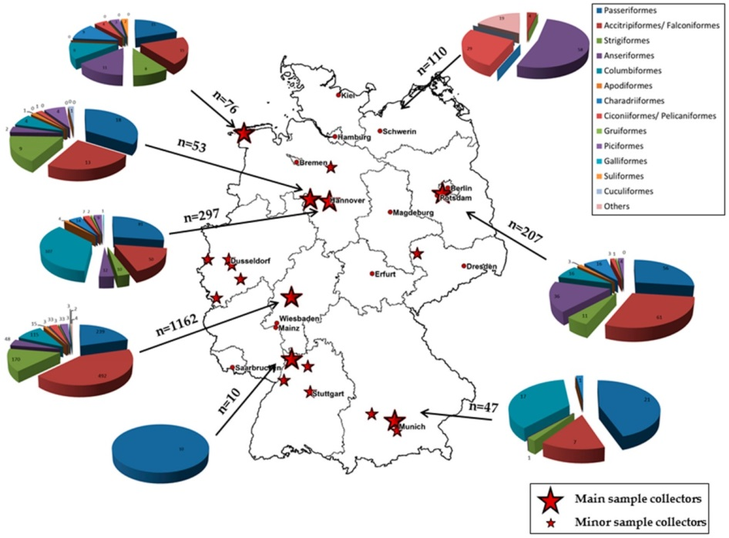
Flaviviridae
Usutu-, West Nile Virus
WNV and USUV positive neutralization assay results from wild bird serum samples in 2014.
Order | Common Name | Scientific Name | Migration Pattern | No. Samples Tested | WNV Pos. (ND₅₀) | USUV Pos. (ND₅₀)
Passeriformes | Eurasian Blackbird | Turdus merula | R, P | 19 | 1 (20), 1 (40) | 1 (640), 1 (15)
 | Eurasian Magpie | Pica pica | R | 2 | 1 (10) | 0
 | Typical Warbler | Sylvia sp. | L | 1 | 1 (10) | 1 (10)
 | Hooded Crow | Corvus cornix | R, P | 12 | 1 (10) | 0
Accipitriformes | Griffon Vulture | Gyps fulvus | zoo bird | 2 | 1 (30) | 1 (10)
 | Northern Goshawk | Accipiter gentilis | R, P | 10 | 4 (10) | 0
 | Common Buzzard | Buteo buteo | R, P, S | 31 | 2 (10), 2 (15), 1 (20) | 0
 | Western Marsh Harrier | Circus aeruginosus | L | 3 | 1 (240) | 1 (15)
 | Red Kite | Milvus milvus | (R), S | 2 | 2 (15) | 0
 | White-tailed Eagle | Haliaeetus albicilla | R, P | 6 | 1 (240) | 1 (120)
 | Eurasian Sparrowhawk | Accipiter nisus | R, P, S | 9 | 1 (10) | 0
Falconiformes | European Kestrel | Falco tinnunculus | R, P, S | 11 | 1 (10) | 0
Strigiformes | Eurasian Tawny Owl | Strix aluco | R | 5 | 1 (10) | 0
Columbiformes | Common Wood Pigeon | Columba palumbus | R, P, S | 13 | 1 (15) | 0
 | City Pigeon | Columba livia f. domestica | R, (P) | 21 | 1 (10), 1 (15) | 1 (10), 1 (20), 1 (15)
Anseriformes | Egyptian Goose | Alopochen aegyptiacus | zoo bird | 2 | 1 (10) | 0
Gruiformes | Eurasian Coot | Fulica atra | P, S | 1 | 1 (15) | 0
Total |  |  |  | 248 | 22 | 3
No West Nile RNA detected, but 58 out of 1.825 wild bird sera showed specific neutralizing
antibodies against WNV.
Four wild bird blood samples tested positive for USUV-specific RNA. Additionally, 73 USUV-positive birds were detected in the 2016 dead bird surveillance.
From: Michel et al. (2018) West Nile Virus and Usutu Virus Monitoring of Wild Birds in Germany Int. J. Environ. Res. Public Health 15, 171

Slide 14
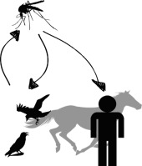
Usutu Virus
Flavivirus (Arbovirus)
Origin: found in south Africa and first identified in 1959,
named after river Usutu in Swasiland, in Europe since 2001,
in Germany since 2010
Epidemiology: transmission via biting mosquitos (Culex pipiens, Aedes albopictus)
Host spectrum: only wild birds develop a viraemia, especially susceptible: songbirds, owls (meningoencephalitis in immuno-compromised humans)
Histopatho: Hepatosplenomegaly, encephalitis and necrosis in heart, liver, spleen and kidney, with lympho-plasmacytic inflammation
Clinic: rarely clinical cases,
typical symptoms: fever, headache, exanthema
Diagnosis: virus isolation, ELISA, PCR

Slide 15
Species | Common Name | Country (year) | References
Dendrocopos major | Great spotted woodpecker | Belgium (2014) | [29]
Pyrrhula pyrrhula | Bullfinch
Columba livia domestica | Domestic pigeon | Greece (2014) | [30]
Turdus philomelos | Song thrushes | Spain (2012) | [31]
Turdus merula | Eurasian blackbird | Italy (2010–2011) | [18,19,25,26,27,28]
 |  | Germany (2011)
 |  | Hungary (2003–2006)
 |  | Austria (2001–2005)
Alcedo atthis | Common kingfisher | Germany (2011) | [26]
Serinus canaria domestica | Canary
Alectoris rufa | Partridge | Italy (2010–2011) | [18,19]
Asio otus | Long-eared owl
Caprimulgus europaeus | Nightjar
Garrulus glandarius | Eurasian jay
Larus michahellis | Yellow-legged gull
Pica pica | Eurasian magpie
Streptopelica decaocto | Eurasian collared dove
Ardea cinerea | Grey heron | Germany (2011) | [18,19,26]
Merops apiaster | Eurasian bee-eater | Italy (2010–2011)
Passer domesticus | House sparrow
Picus viridis | Eurasian green woodpecker
Sturnus vulgaris | Common starling
Strix nebulosa | Great grey owl | Germany (2011) | [26,27]
 |  | Austria (2001–2002)
Gallus gallus domesticus | Chicken | Italy (2007–2009) | [14,32,33,34]
 |  | Switzerland (2006–2007)
 |  | England (2006)
Spheniscus humboldti | Humboldt penguin | Switzerland (2006–2007) | [34]
Phoenicopterus ruber | Greater flamingo
Dacelo novaeguineae | Laughing kookaburra
Ciconia ciconia | White stork | Austria (2006–2007) | [34]
Leptoptilos crumeriiferus | Marabou stork
Neophron percnopterus | Egyptian vulture
Bubo bubo | Eurasian eagle owl
Bubo scandiacus | Snowy owl
Strix uralensis | Ural owl
Avian species infected with USUV in Europe.
from: U. Ashraf, J. Ye, X. Ruan, S. Wan, B. Zhu, S. Cao (2015) Usutu virus: an emerging flavivirus in Europe. Viruses. 7, (1): 219–238,

Slide 16
Usutu virus spreads among birds in Germany
Birds in Germany are dying of the African Usutu virus. The disease is transmitted by mosquitoes. Blackbirds in particular have been infected in recent years

Slide 17
West Nile Virus
Flavivirus (Arbovirus)
Origin: isolated from a human patient in Uganda in 1937
Epidemiology: transmission via biting mosquitos
Host spectrum: only wild birds develop a viraemia, poultry not (exception: geese), especially susceptible: Corvidae, some mammals (exp. Horses)
Histopatho: no pathognomonic lesions, neuro- and viscerotrophic virus, lesion in ZNS, liver, kidney, spleen, heart
Clinic: per-acute to acute course
unspecific symptoms : paralysis, tremor, torticollis
Diagnosis: virus isolation, ELISA, PCR

Slide 18
WNV in Germany
First reported in a great-grey owl
from a zoo in Halle (Saxony-Anhalt) in August 2018
In a captive gret-grey owl in Bavaria at 12.09.2018
In a captive Goshawk in Saxony at 19.09.2018
In a horse in Brandenburg at 21.09.2018
Until the end of September the virus has been detected in a total of 10 owls, trushes, birds of prey, one horse and a human.

Slide 19
European Centre for Disease Prevention and Control
An agency of the European Union
West Nile fever in Europe in 2018 - human cases compared to the previous season; updated 28 September
In 2018, as of 27 September 2018, EU Member States have reported 1.266 human cases: Italy (495), Greece (261), Romania (237), Hungary (190), Croatia (44), France (16), Austria (15), Bulgaria (5) and Slovenia (3). EU neighbouring countries reported 404 human cases: Serbia (320), Israel (81) and Kosovo* (3). To date, 124 deaths due to West Nile virus infection have been reported by Italy (36), Romania (30), Serbia (29), Greece (26), Bulgaria (1), Hungary (1) and Kosovo* (1).
During the current transmission season, 201 outbreaks among equids have been reported by Italy (107), Hungary (78), Greece (10), France (2), Romania (2), Austria (1) and Germany (1).

Slide 20
West Nile
Virus in the USA
year | cases | human death | horses | horses dies | birds died
1990 | 62 | 7 | 25 | 9 | 700
2001 | 66 | 8 | 738 | 243 | 7.338
2003 | 9.862 | 264 | 5.181 | 1.554 | 11.597
total | 16.702 | 654 | 22.602 | 6.781 | 47.016
Proven cases of encephalitis
and/or meningitis
in humans in the USA

Slide 21
138 bird species have been reported to CDC's West Nile Virus Avian Mortality Database from 1999 to November 2003
Robert B. Tesh: Cross Immunity: West Nile vs. St. Louis Encephalitis in Areas of Overlap

Slide 22
Thank you for your attention…

