Slide 1
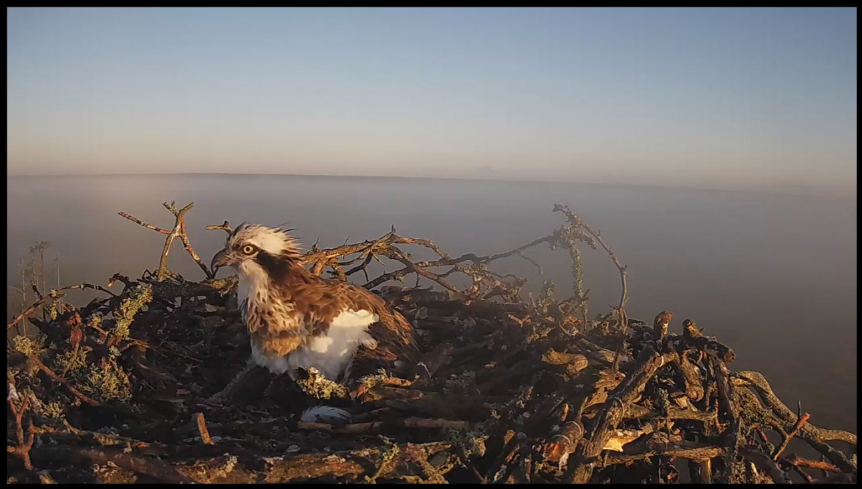
INTRASPECIEFIC RELATIONSHIP,
ECOLOGY AND CHRONOLOGY OF THE BREEDING, FOOD COMPOSITION AND SEASONAL MOVEMENT OF OSPREYS (Pandion haliaetus)
FROM NORTHERN BELARUS
Denis Kitel
Scientific and practical center on game and wildlife management,
Interservice Ltd., Izubrica vill., Verhnedvinsk distr., Belarus
Anastasia Kazakova
Biological dep., Belarus state university, Minsk, Belarus

Slide 2
Research area: Belarus, Vitsebsk reg., Rossony and Verhnedvinsk distr., Krasnyj Bor and Osvejskij
Nature reserves, neighboring areas

Slide 3
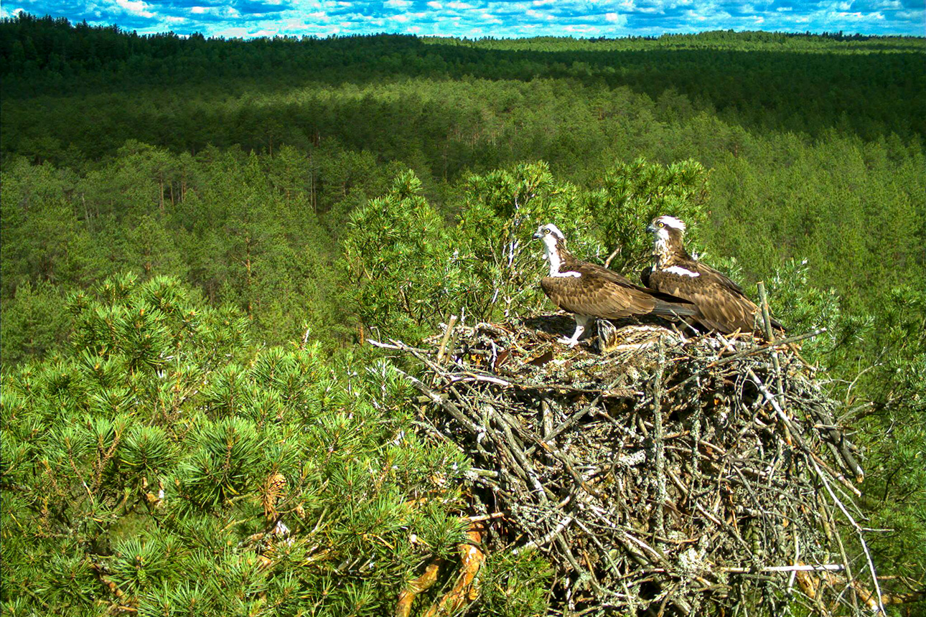
For first time a web-camera and a photo trap were installed near the nest of Osprey in 2017.
Two accumulators were used as a source of energy, we did not have amplifier.
The quality of translation was weak, accumulators had to be changed and charged every 3-4 days.

Slide 4
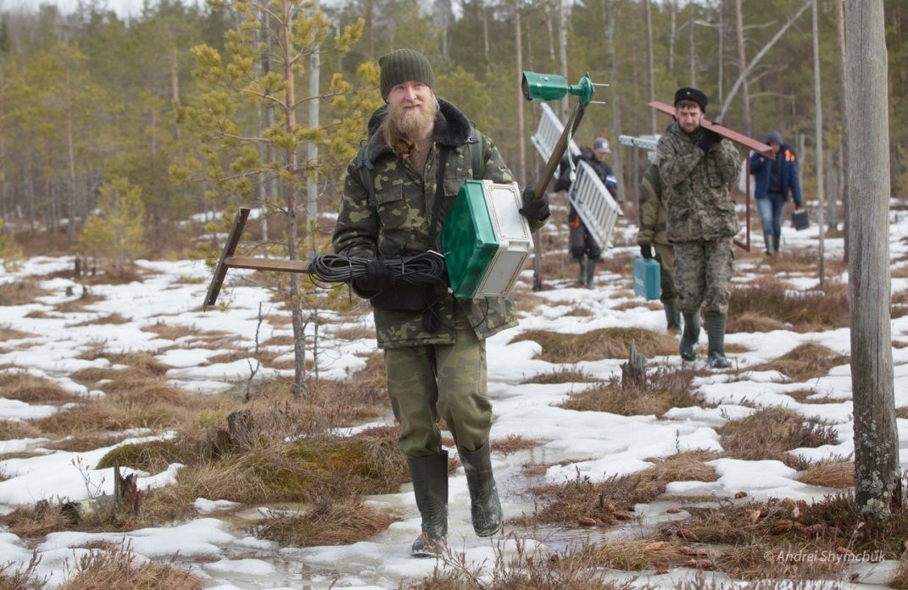
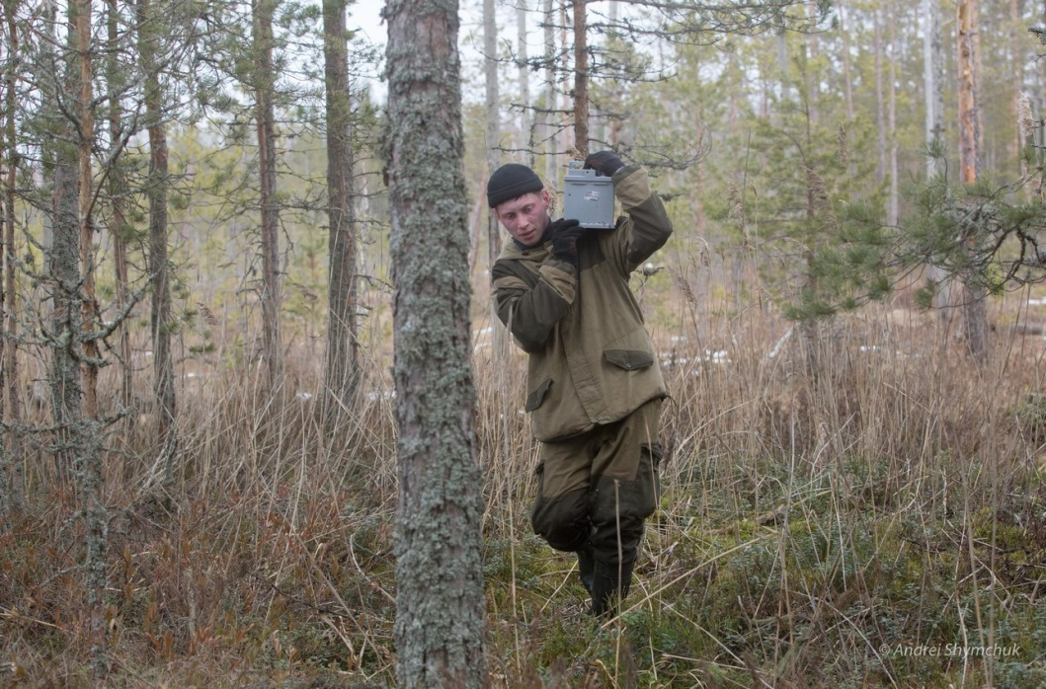
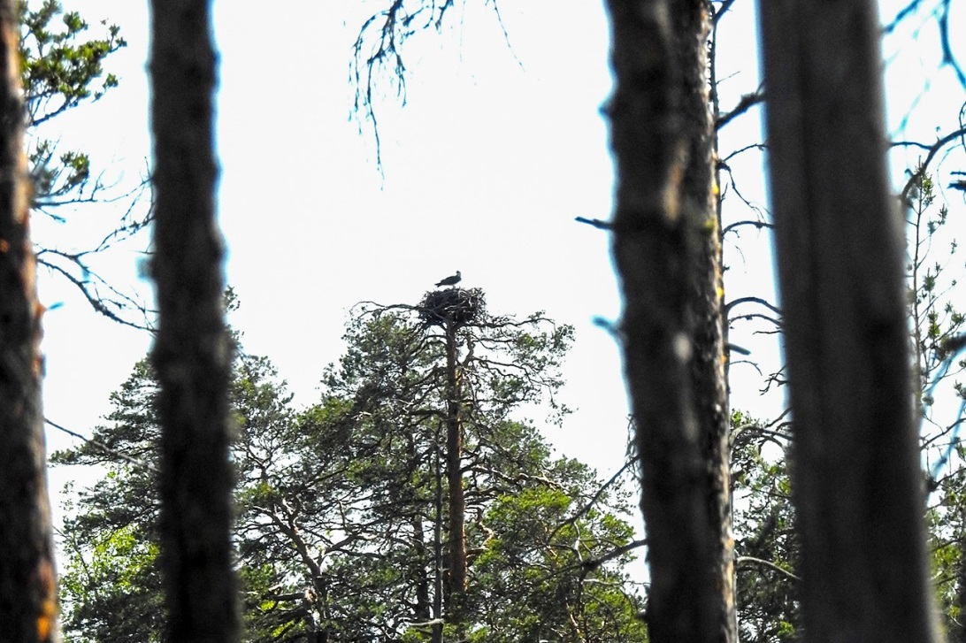
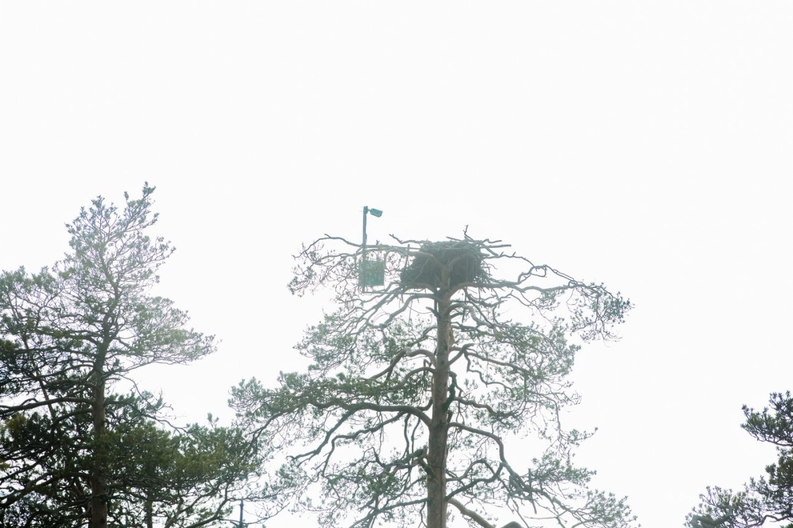
Second time a web-camera was installed on April, 4 in 2018.
Two solar panels and amplifier (for continuous 3G signal) were added to the construction.

Slide 5
Period of translation: April, 4 – July, 5

Slide 6
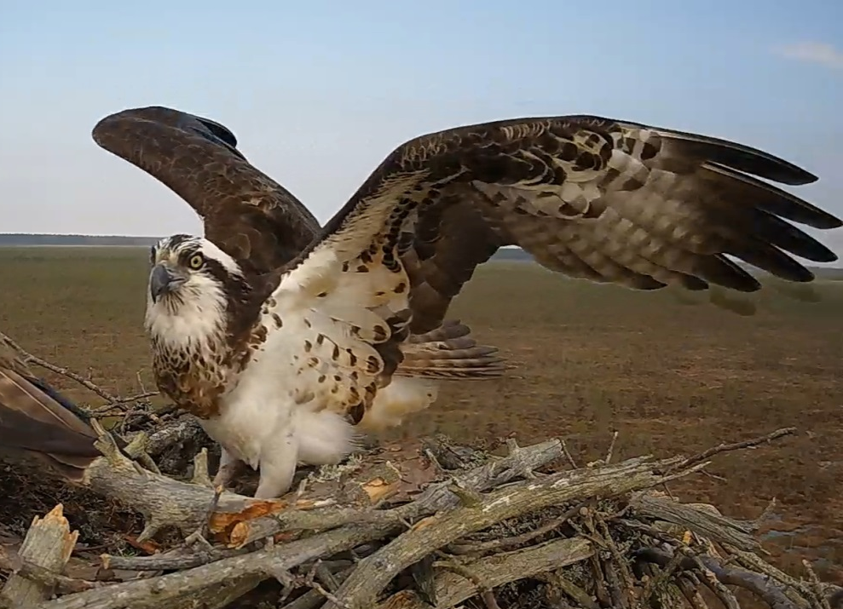
At least 4 different females visited the nest.

Slide 7
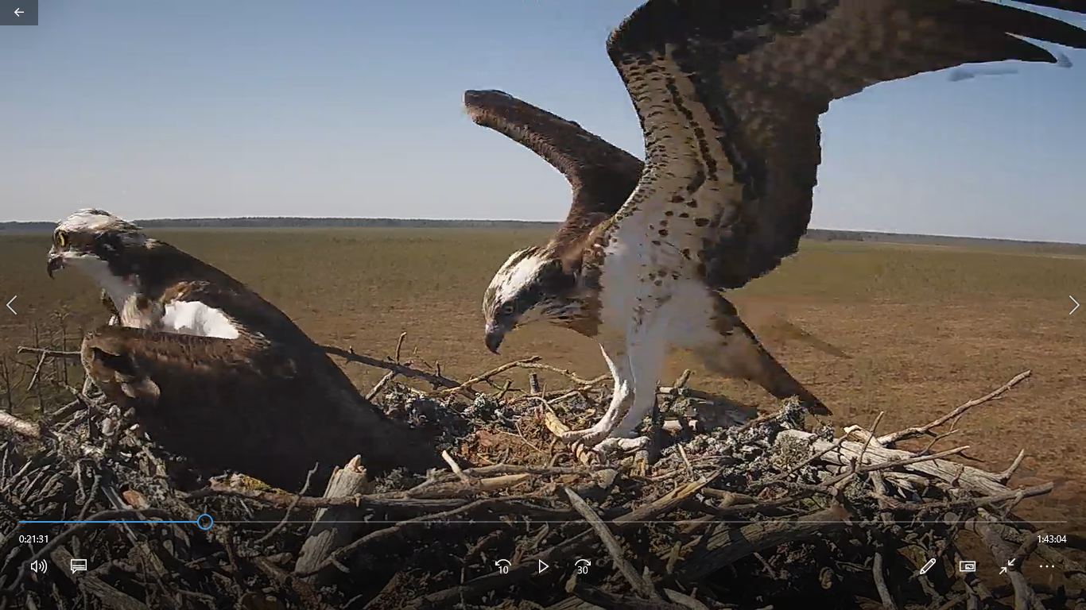
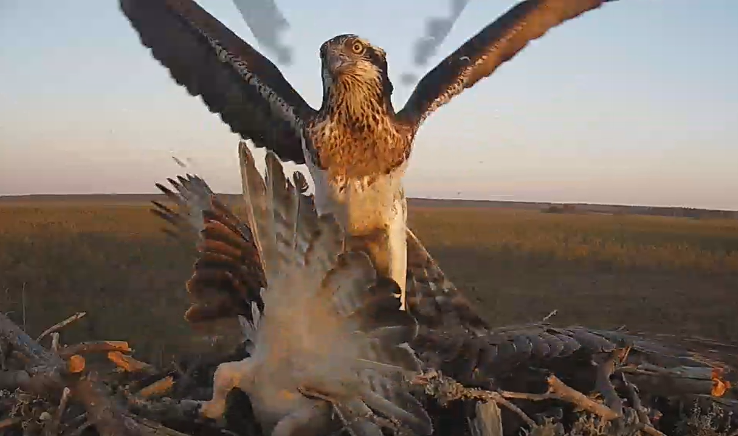
Male mated with at least three females 59 times.
One female was found later 11 km away from the nest
with camera. She was with another male and with
chicks.

Slide 8
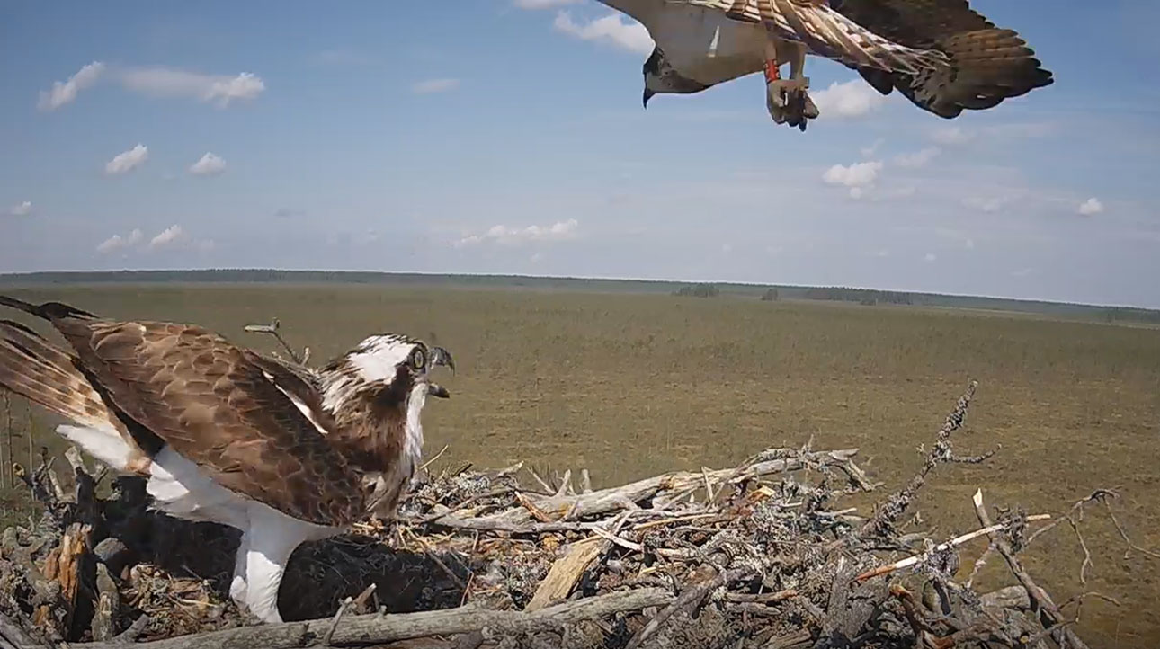
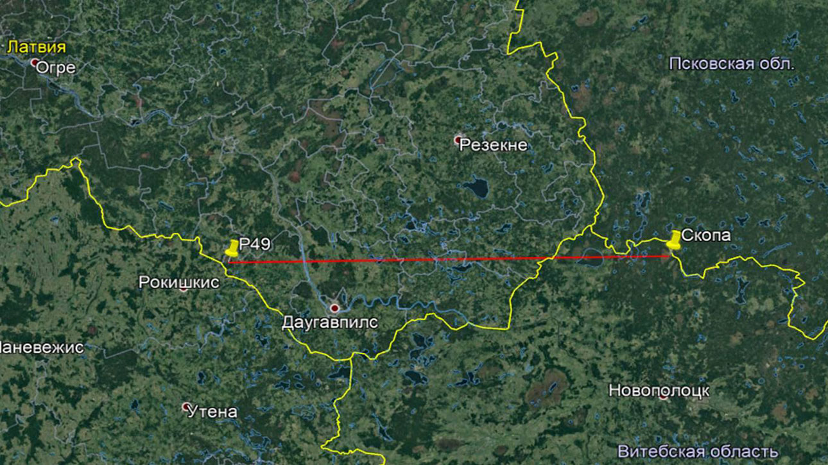
On May, 18 Osprey with color
ring flew over the nest with
our camera. The ring was
read. The bird was ringed
as a chick in Latvia in the
distance of 173 km
on July, 7 in 2016.

Slide 9
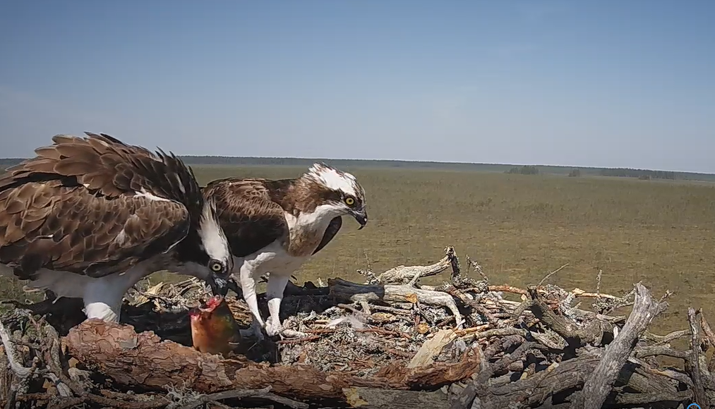
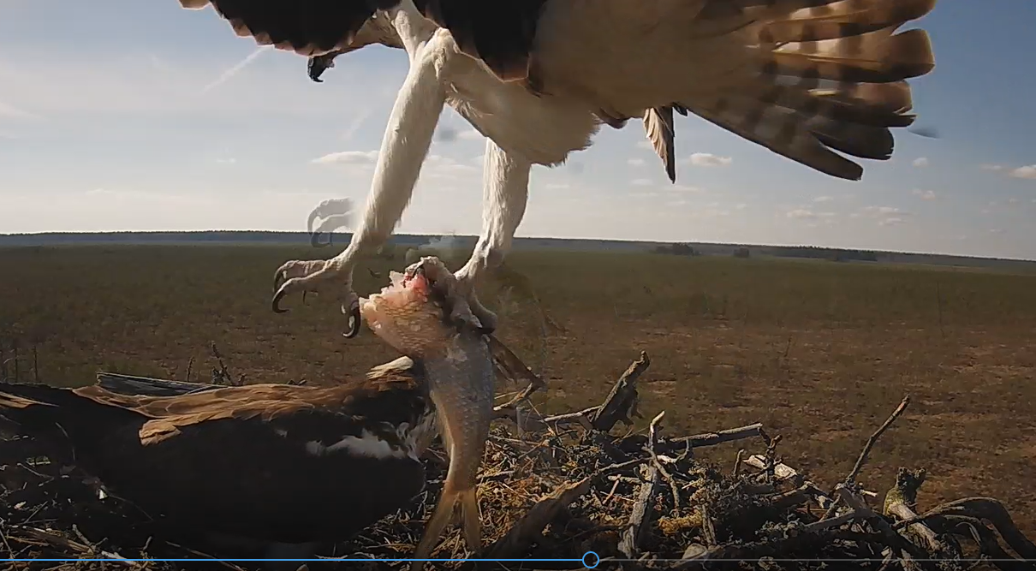
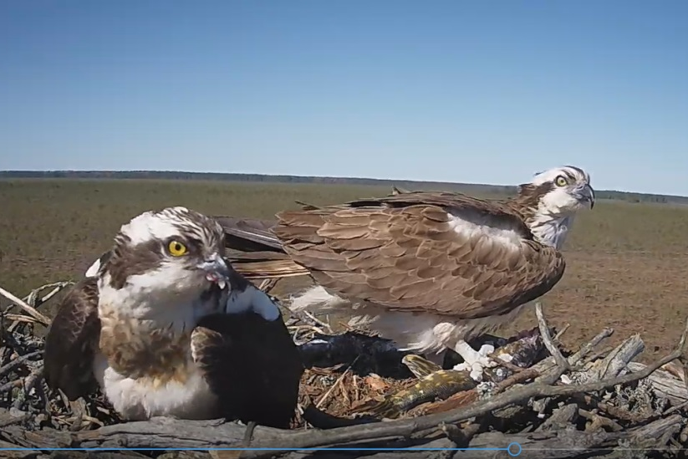
During period of translation (from
April, 6 to June, 22) 253 fish were
brought to the nest
(from 1 to 9 a day).
The species identified:
Common Bream (Abramis brama)
European Perch (Perca fluviatilis)
Tench (Tinca tinca)
Northern Pike (Esox lusius)
Prussian Carp (Carassius gibelio)
Roach (Rutilus rutilus)
Common Rudd
(Scardinius erhythrophtalmus)

Slide 10
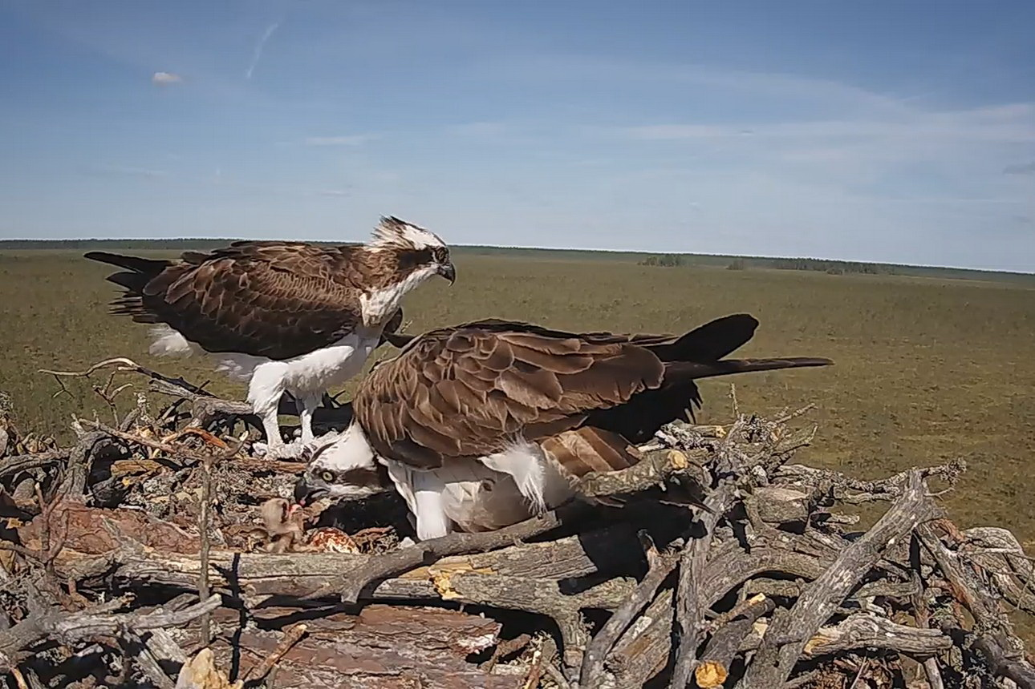
First egg was laid on April, 23, second on April, 26, third on April, 29.
First chick was hatched on May, 30, second on June, 2, third on June, 3.

Slide 11
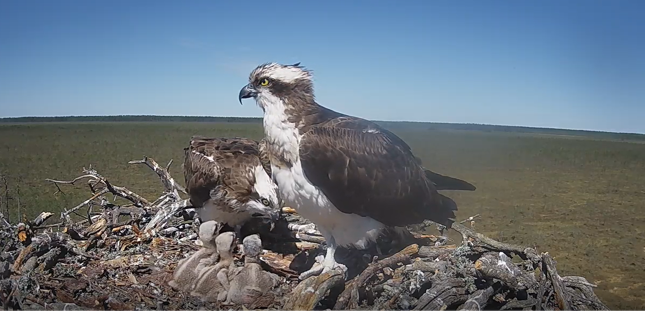
On June, 13 female unexpectedly leaves the nest and disappears. She never came back to the chicks. We do not know what happened with her. Male continued bringing food to the nest and even fed the chick but did not warm them. In some days after the rain chicks were frozen and dead.
Translation to the Internet was stopped…

Slide 12
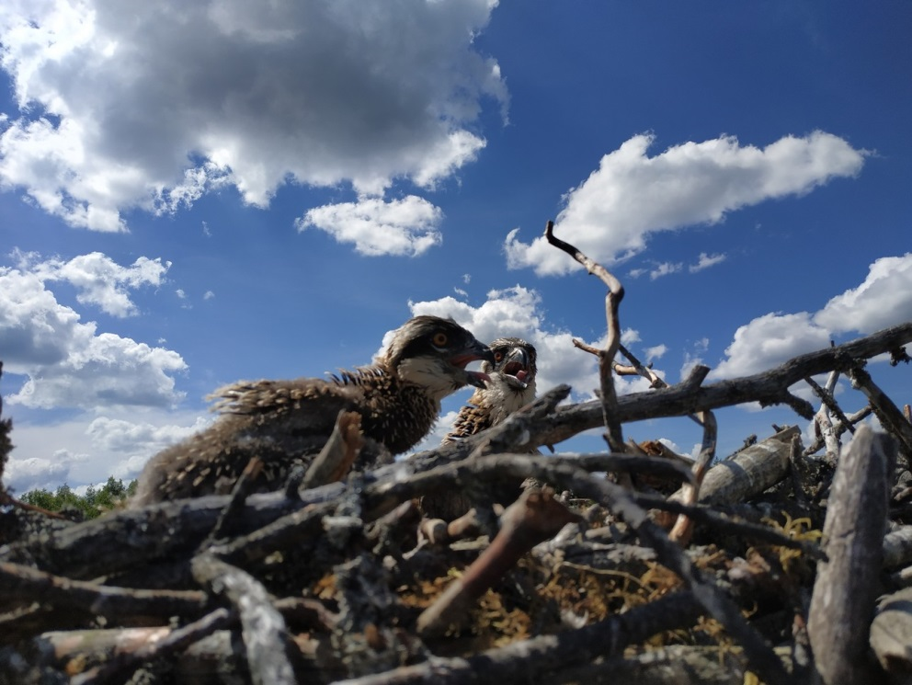
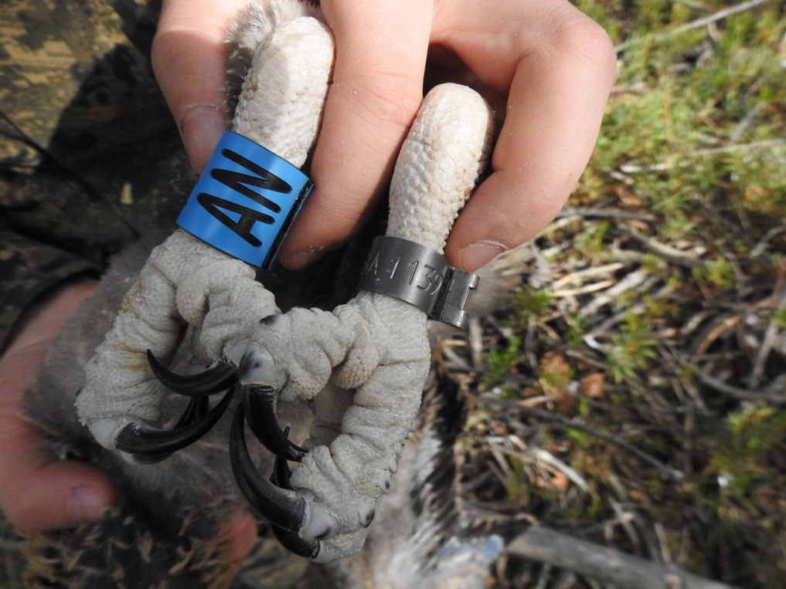
 | 2017 | 2018
Number of active nests* (at least one egg laid) | 7 | 8
Number of successful nests (et least one chick fledged) | 6 | 6
Productivity (fledging/active nest) | 1,71 | 1,63
Breeding success | 86% | 75%
Number of chicks fledged. | 13 | 13
*the density of Ospreys in this region was estimated as 16,7 pairs/ 1000 km2 (Ивановский, 2012)

Slide 13
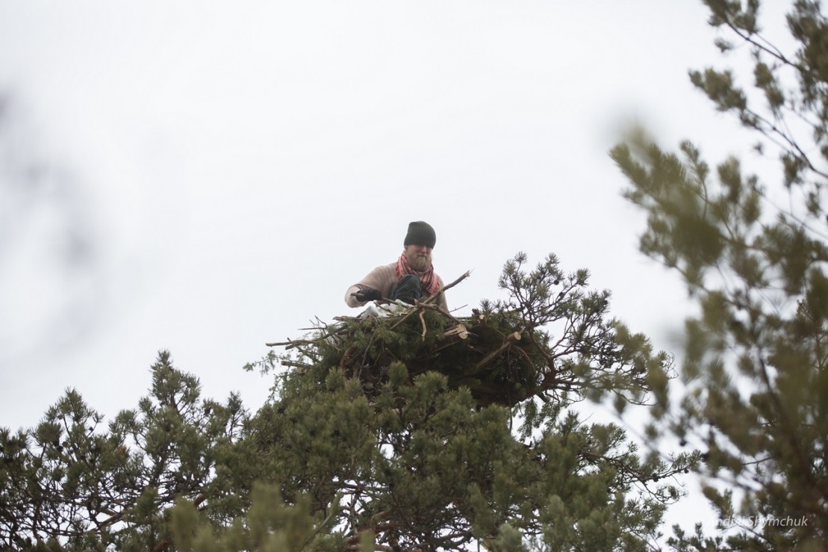
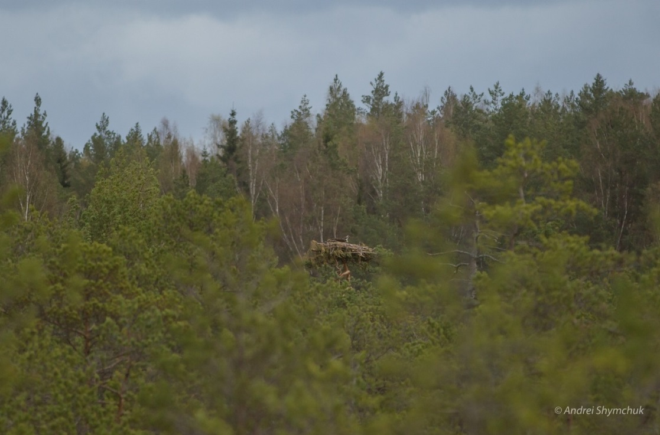
3 pairs of Ospreys live on artificial platforms.
Some of them were built more than 10 years ago.

Slide 14
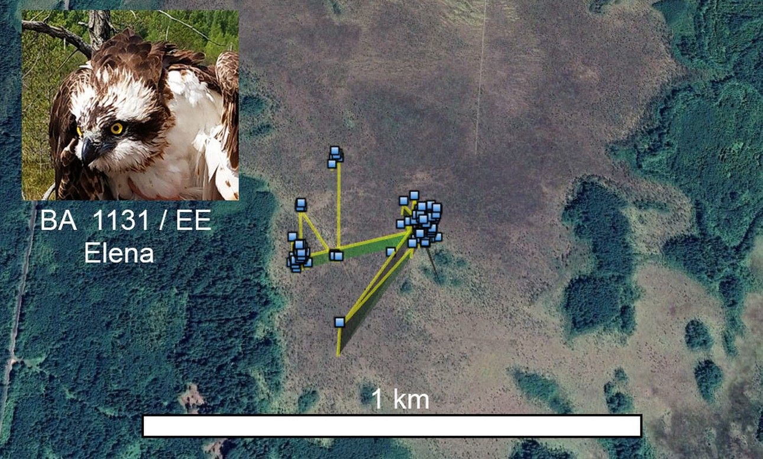
when chicks are in the nest

Slide 16
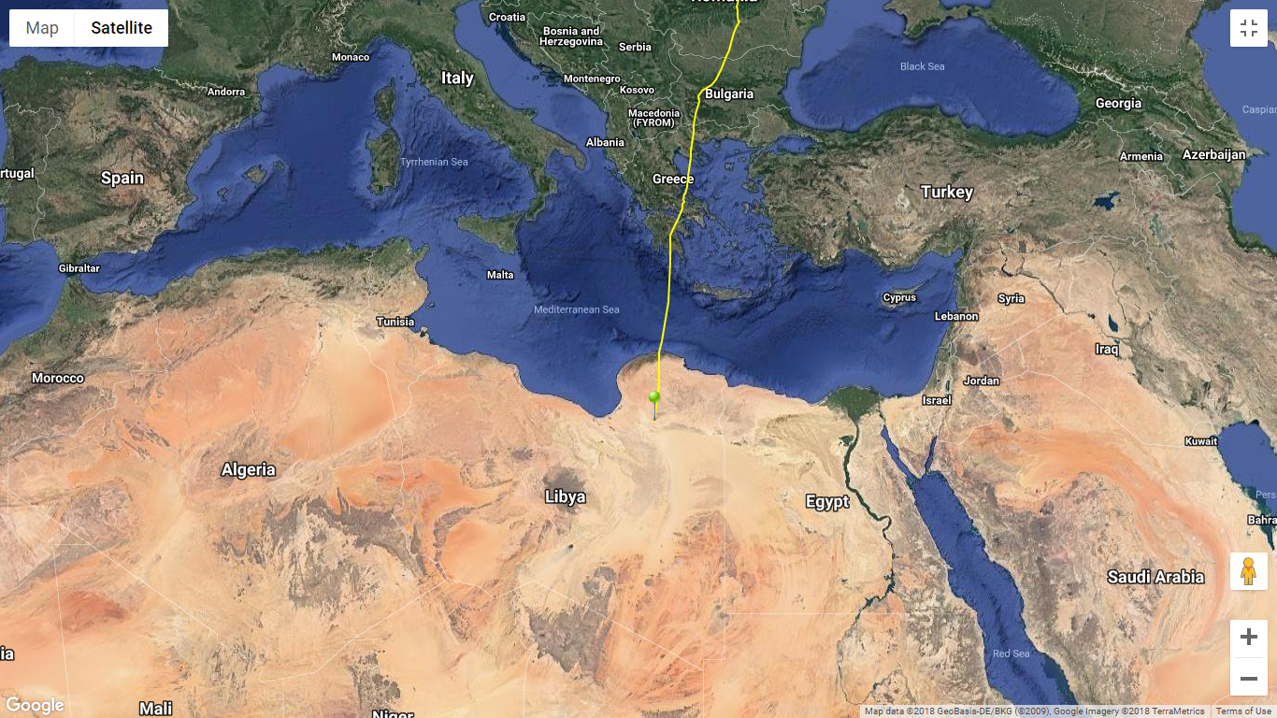
Elena came to Libya on September, 2

Slide 17
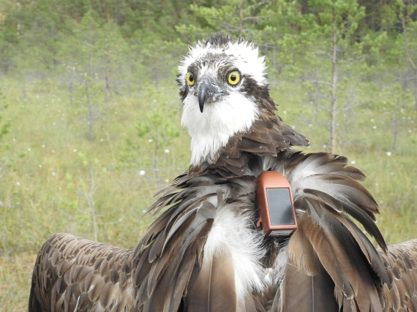
Vova BA 0553/VV
during breeding season
22.06.-11.08
1 км

Slide 18
Vova was in Bulgaria on September, 8

Slide 19
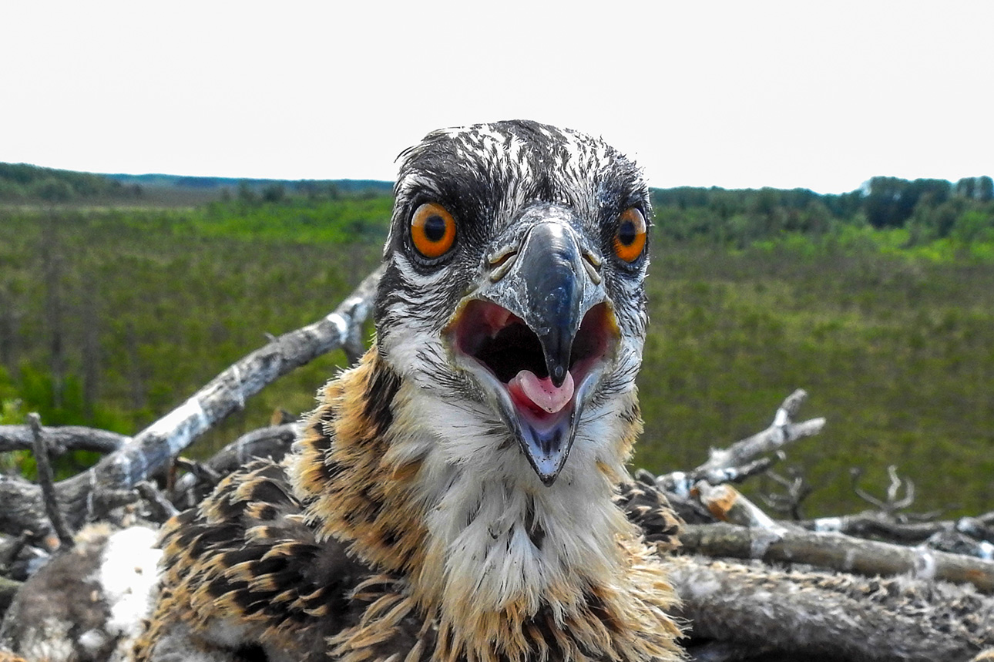
Thank you for attention!

